Slide 1
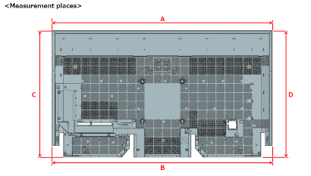
检测项目内容：
主要检测项目：
1.外径寸法： OUTLINE DIMENSION长宽尺寸，变形 ---优先
2.混料防止：同一幅模具的部品，不同镶块检测 *同一部品上的洞孔不同
3.子部品的缺失检测
4.外观检查（熔接线，色差，BURR…)
55”外形尺寸Spec：+/-0.6mm
65”&75”85”外形尺寸Spec：+/-0.8~1.2mm
*治具检查精度由治具供应商定义

Slide 2
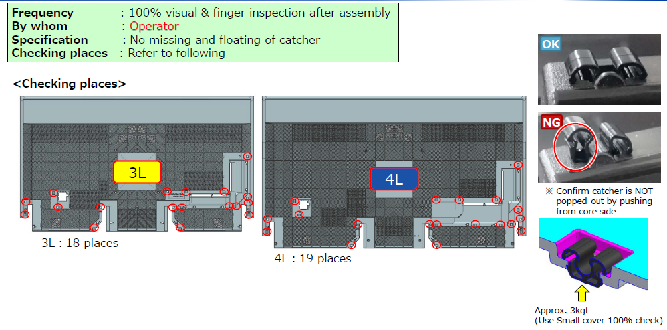
检测子部品缺失 sub-components defective inspection

Slide 3
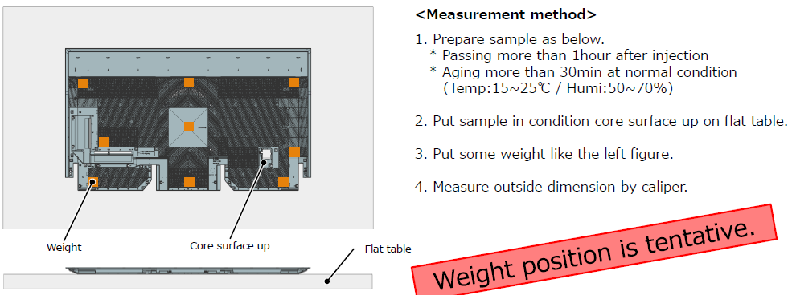
要求说明求
1）该检测治具兼容4款后盖产品（55“~85”）的尺寸检查，生产节拍低于30S/台，最终提供给索广的部品供应商生产线使用。
2)部品的重量是85“: 7700g, 55”: 3100g, 部品的公差要求±0.6mm（移动平台，校验标准件，Sensor）
3）治具的测量方式需要符合设计指示的测量方法如下图：
①放置在平板上 ②部品固定位置上需压块防止变形），放置压块请考虑使用液压系统,高度不在一个平面上
4)测定结果记录保存和可导出（部品上有QR条形码）
5) 治具流出的检验容错率为0，索广会提前提供实物样品做验证。
6）治具完成前的检证，进度管理，问题分析全部由治具厂家对应完成。
设计指示的测量方法

Slide 4
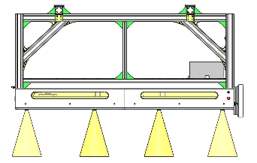
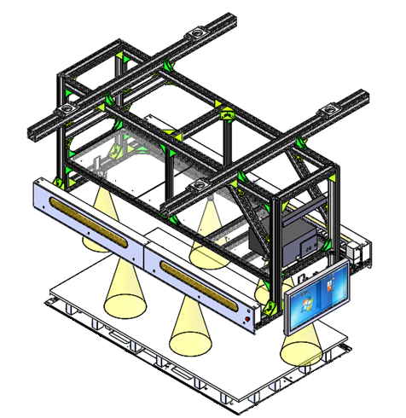
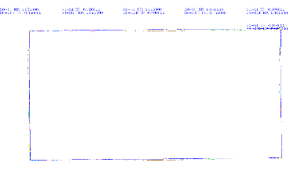
Automotive inspection scheme1
Inspection accuracy：0.06mm
★
■Automotive inspection system:（<15s/pc）
The precision of camera mode which discussed within inner side can not be meet , so looking for the outside sourcing.
■Inspection principle
For industry
4KCamera*2
For indsutry
4KCamera*1
カメラ
central processer
（Self-development SOFT）
BC
Process the acquired BC image through camera shooting and display the OK / NG judgment result.
※Sample例
（ Automated inspection items: Warping、deformation、size etc. of 4 sides.)
inspection result display
out frame dimension have detected failure
For industry
4KCamera*2
For industry
4KCamera*1
BC
out frame dimension have detected failure
failure detected
（N：decide by inspection content）
※Camera qty&Camera mobility or fixed：depend on final inspection content and result .
・Picture shooting（2times）、2S /time、total5S ・inspection accuracy：0.1mm (規格：±1.5mm)
55”～85 “Full support
※COST：約
Technology Development Dept.

Slide 5
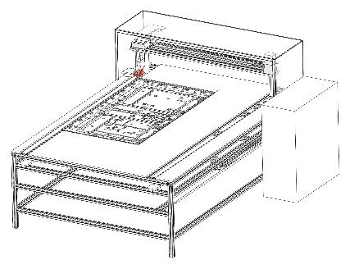
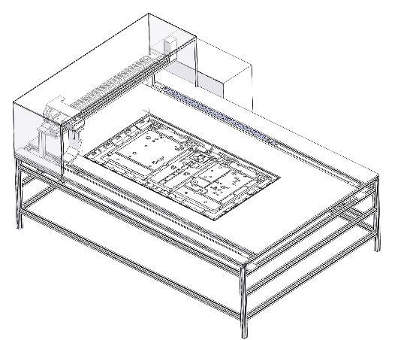

Automotive inspection cheme2
★
Inspection accuracy：0.06mm
Sensor mode：Specification accuracy can be met or not?
The quotation ・ LT are urgent
■Automotive inspection system:（30s/pc）
Y axis
Electronical control
X axis
4sides movement measurement
85 “
＜side view＞
75”
65”
※COST：
Item | Parts | Quotation（Thousand）
1 | movement control unit
2 | Detection pin control unit
3 | frame
4 | Countertop cradle and switching unit
5 | Electronical control
 | Total
Mobile 3D measurement device*2
Frame side/top
RC
）High precision platform
Including positioning pins of each model
・Point：The deformation prevention of BC is required during staff handing
Technology Development Dept.

Slide 6
EoF

